Slide 1
Exercise 15
Phylum Mollusca

Slide 2
In this lab exercise, you observed the diversity of animals in the phylum Mollusca. You will be expected to recognize each group and their distinguishing characteristics. Consult your lab manual for the structures that you will need to recognize on each specimen. In addition, you need to identify organs on the clam dissection or clam model and know their functions. As in all exercises, concentrate on those structures in bold face type and those that you were asked to label on your diagrams.

Slide 3
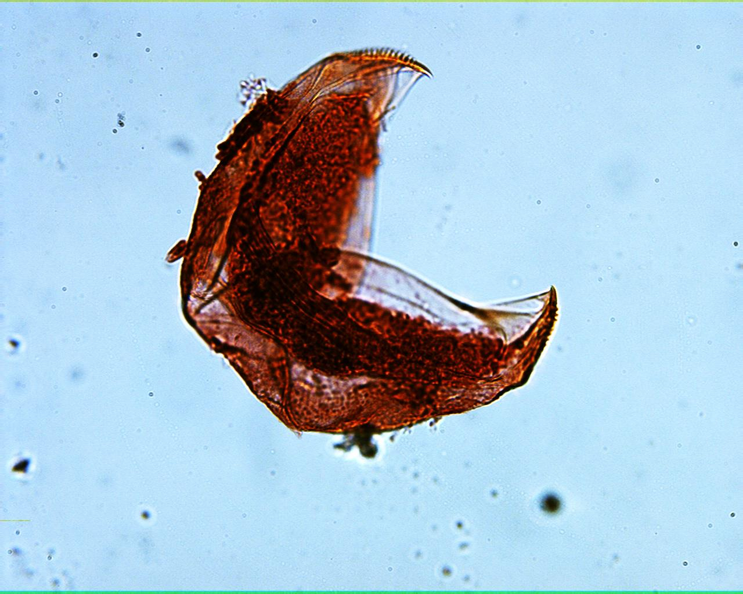
Glochidium larva 100X

Slide 4
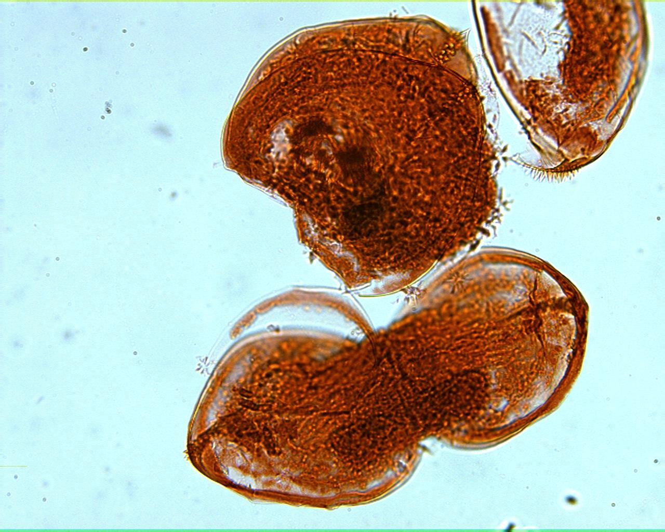
Glochidium larva 100X

Slide 5
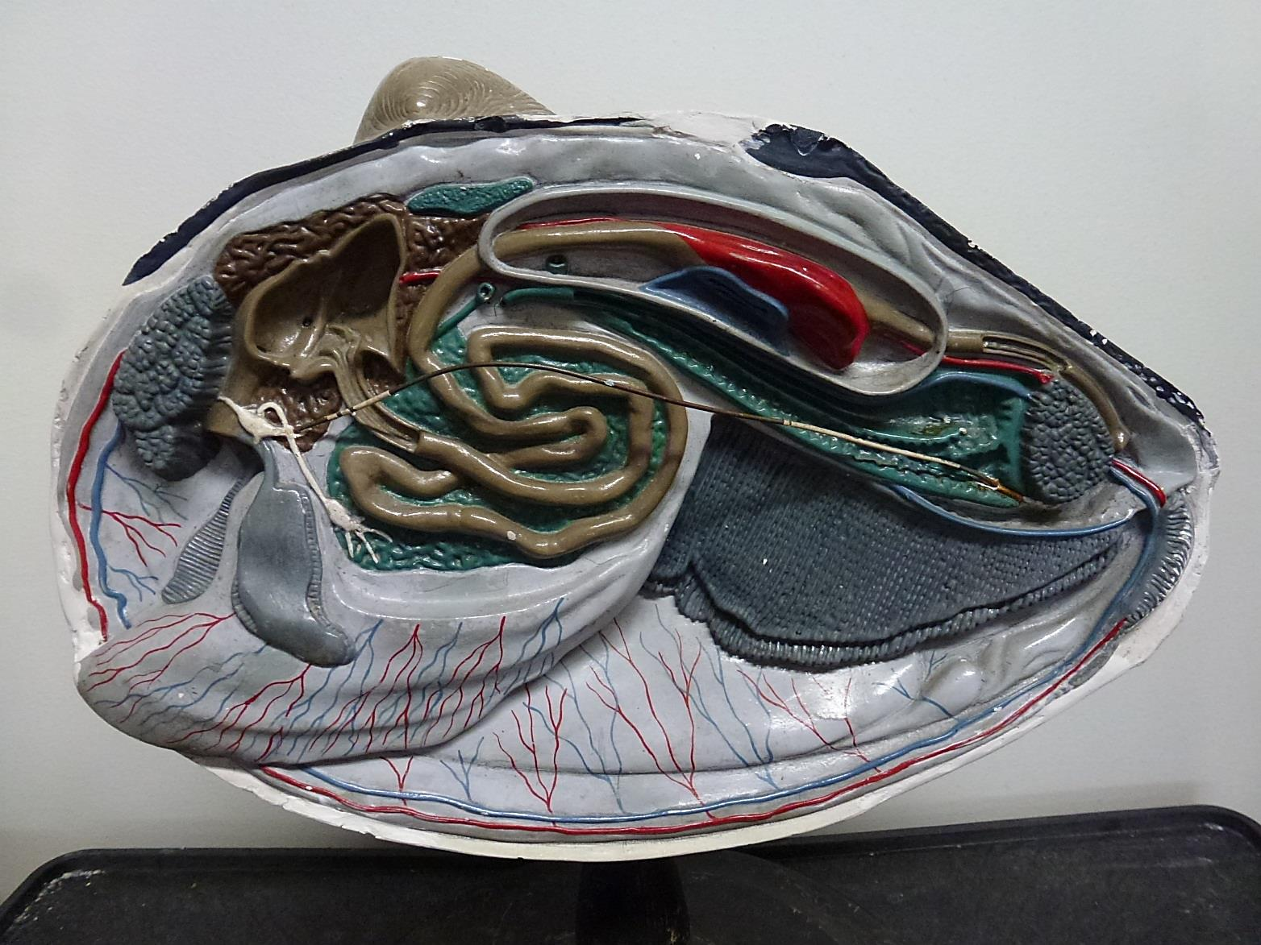
Clam Model Sagittal

Slide 6
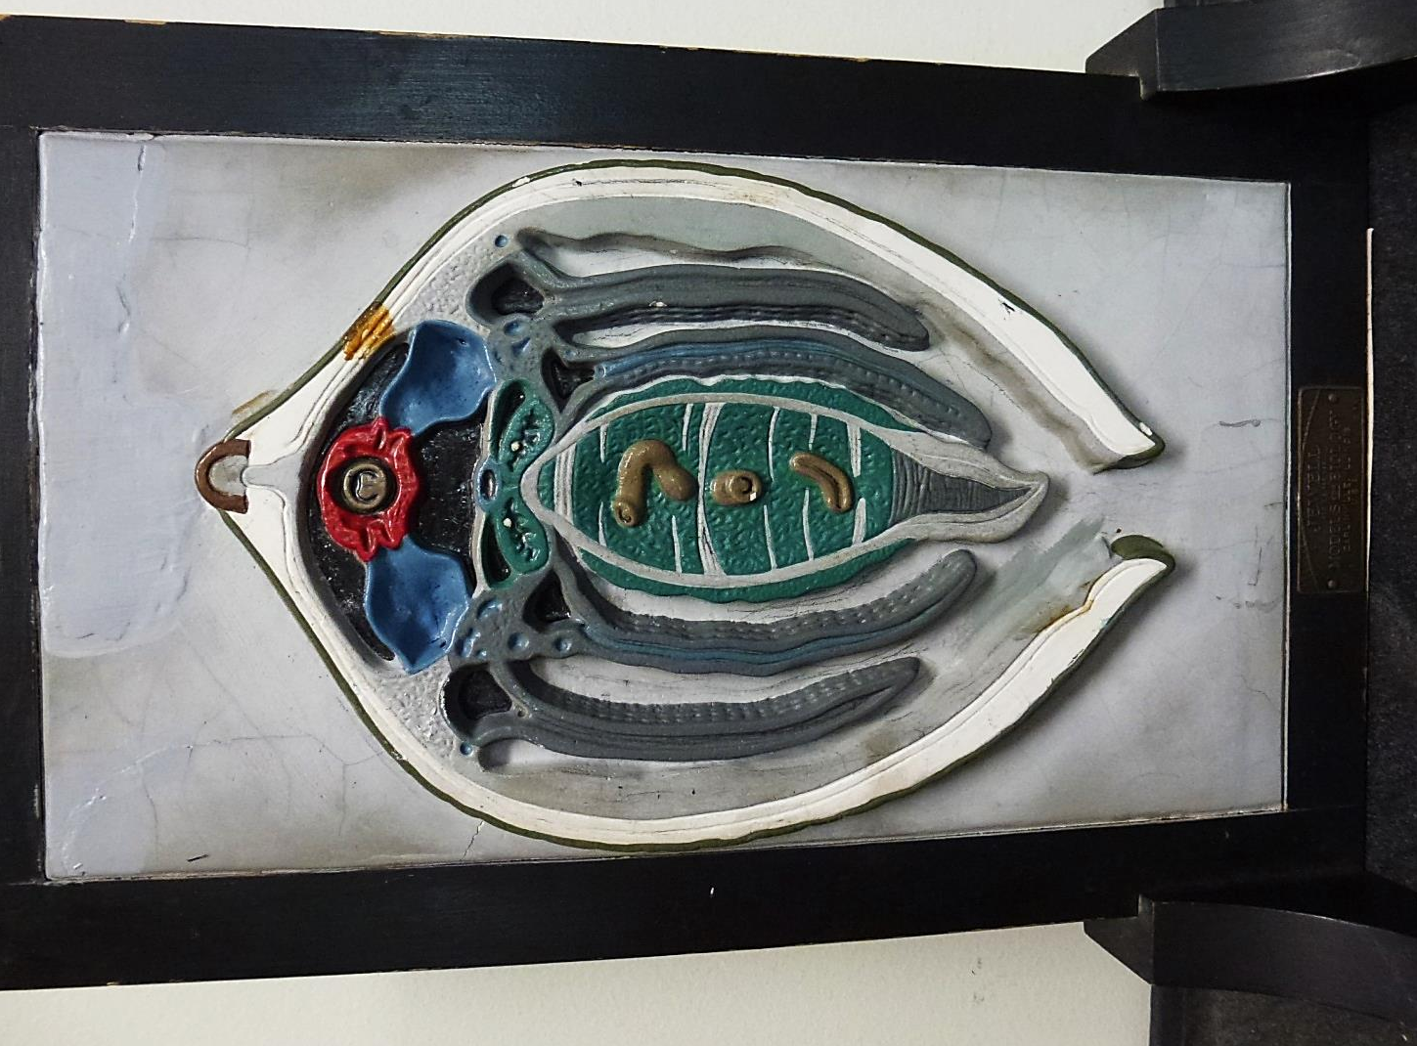
Clam Model Transverse

